Slide 1
Pittsburgh bus ridership before and during Covid
Gopal (Sharath) Sharathchandra
Project 1
Data Science Fellow
NYC Data Science Academy Bootcamp #25

Slide 2
Objective
Analyze patterns in bus ridership in Pittsburgh, PA before and during covid
Lay foundation for gaining insights and forecasting ridership once offices and schools open over next 3-4 months
Given the steep drop in bus ridership during covid, an understanding of how much, how quickly and in what manner ridership will recover has important implications for
Operational decisions by Port Authority of Allegheny County (transit authority) e.g. level of bus service to maintain, reallocation of bus service across routes
Business activity – a sustained drop in ridership due to increased work from home arrangements can impact
Commercial real estate – office space demand
Business activity reliant on officegoers e.g. lunchtime eateries, downtown shopping
County/state level planning and decision making
Lower tax revenues due to decreased business activity
Other e.g. different traffic patterns due to fewer buses but more cars on roads if people switch to cars from riding buses

Slide 3
Data
Dataset obtained from Western Pennsylvania Regional Data Center (link below)
https://data.wprdc.org/dataset/port-authority-monthly-average- ridership-by-route
Data set attributes
Average ridership by route for each month
Broken out by average weekday, Sat, Sun
Covers bus, light rail (‘T’), incline
From Jan 2017 to Mar 2021
11,884 rows x 10 columns, csv file
For this study, I have focused on ridership data for buses and on weekdays
As part of data cleansing, I excluded three bus routes (details in appendix)
Dataset used thus has average weekday ridership for
51 months (Jan 2017 to Mar 2021)
95 bus routes

Slide 4
Summary of findings – before Covid
Code and data can be found at
https://github.com/gopalsharath/pitt-bus-ridership.git
Average weekday ridership across all routes
185,000 in 2019 and 2018
179,000 in 2017
Top 10 bus routes in terms or ridership account for 33% of total (see appendix)
All 10 serve downtown, 8 pass through both major universities
Ridership shows seasonality (see appendix for graphs of aggregate ridership as well as of ridership for selected routes)
Peak is Sept with smaller peak during Jan-Mar
Troughs are in Dec and June
Seasonality appears stronger in buses serving major universities (see graphs for 61C and 71C) versus buses directly serving downtown (see graphs for buses P1 and 51)
This is intuitive given that many students may leave during semester breaks

Slide 5
Summary of findings – during Covid
Steep decline in aggregate ridership during covid, relative to 2019 average level ridership falls by (see appendix for graphs noted on prior slide)
73% in April 2020
70% in Dec 2020
65% in Mar 2021
Median ridership declines by around 60% (see appendix for boxplot comparisons)
Seasonality partly intact during 2020
Appears disrupted during Apr-June, likely given shock of covid lockdown
However, more normal seasonality seen during July-Sept and during Sept-Dec
Recent upward trend during Dec’20 – Mar’21 also consistent with seasonality, so rising trend in Mar may not yet reflect more opening of economy
Distribution of percentage drops in ridership across all bus routes tells a similar story to what is seen at the aggregate level (see appendix for box plots)
The distributions are slightly tighter in Dec’20 and Mar’21
Level of Mar’21 distribution indicates a slightly smaller drop
However, as noted above, this could be due to seasonality
Overall, too early to tell if there is a secular pickup in ridership as of Mar’21

Slide 6
Future work
Given anticipated pace of reopening of work places and of universities, it would be opportune to repeat the analysis using data refreshed as early as Sept’21
Further, Port Authority has announced elimination of capacity constraints on buses by June 20, 2021
Study may then need to be repeated at frequent intervals (e.g. monthly) thereafter to better identify ridership trends
Trend may need to be separated from seasonality for better forecasting
Analysis can also include light rail data, which would add some more data points
Unclear how to Sat/Sun ridership data into the analysis at present, however, useful insights could reside in them
This analysis is likely to add to the growing interest in understanding the post covid impact of working arrangements - i.e. is a part of the workforce going to be permanently working from home, either full time or part time ? – and the implications of this for the broader economy

Slide 7
Appendix

Slide 8
Background
Port Authority of Allegheny County operates buses, light rail and inclines
Pittsburgh’s geography – rivers, hills that create fewer points of entry into city - as well as limited parking, particularly in downtown, make it more conducive for public transport
Pittsburgh has a Busway – a railroad track converted to a dedicated road for buses - that offers speedy connections between downtown and points east (e.g. bus route P1 uses Busway, see appendix for map) which is also conducive to public transport
Pittsburgh is also a college town with several major universities and other smaller universities with students being key users of buses (e.g. bus route 61C serves both CMU and U of Pitt on way to downtown, see appendix for map)

Slide 9
Data cleansing details
Data on the following bus routes was excluded
‘MNT1’
it was unclear if this was even a bus route or was just a data error
further the data were very sparse and sporadic across the time period
Route 68 – data was available for only 30 for the 51 weeks
Route 78 – data was available for only 8 out of the 51 weeks

Slide 10
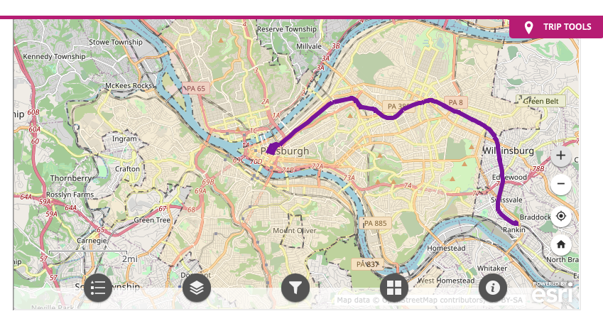
Bus route P1 – travels to downtown along the Busway

Slide 11
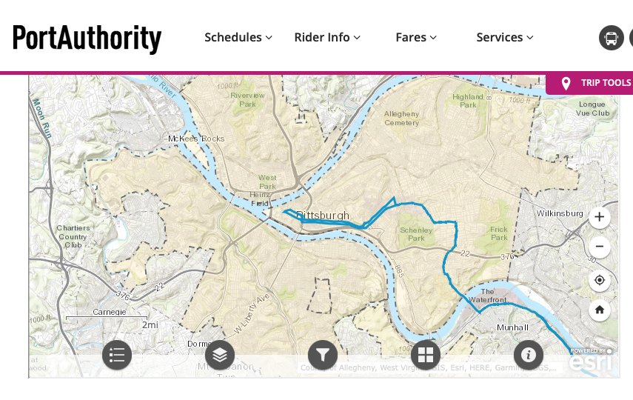
Bus route 61C – travels to downtown passing through CMU and U of Pitt

Slide 12
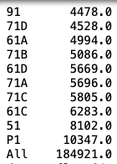
Top 10 bus routes – average weekday ridership in 2019

Slide 13
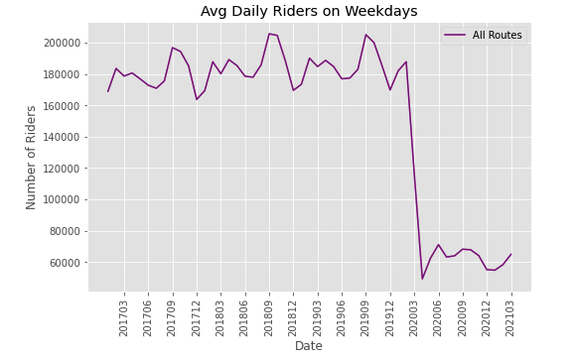
Aggregate weekday ridership

Slide 14
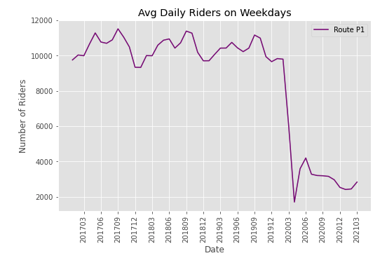
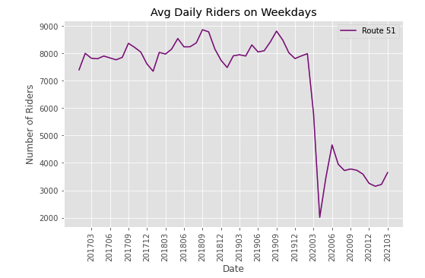
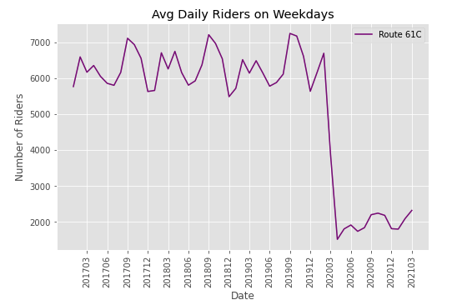
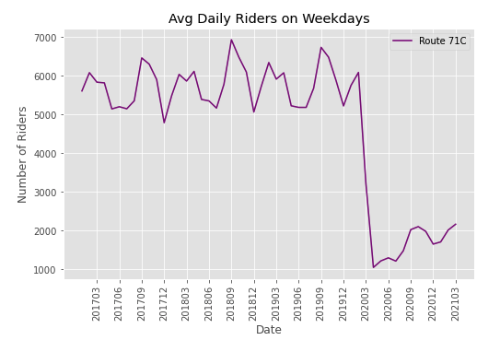
Weekday ridership across bus routes P1, 51, 61C and 71C
P1, 51 show less seasonality than 61C and 71C, likely because they go directly to downtown without passing through the major universities

Slide 15
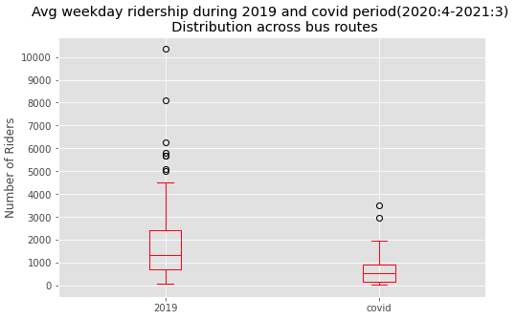

Slide 16
